Slide 1

Introduction to Software Testing

Slide 2
Preview to the Review
Let S = the set of material taught in the course
Let T = the set of material on the exam
T ⊂ S
S
T

Slide 3


Lesson 1: Course Overview
Input
Expected Output
Actual Output
___ P ___ F (depending on actual output)
(plus notes)
In general, four components per case. What are they?
What does “Fail” mean here?
For example:
Collect the quiz scores and calculate the average,
not including the lowest score.
Test Case 1
Input: 80, 83, 88, 91
Expected Output: 87.3
Actual Output:
DID THIS TEST PASS?
87.3333333333
W.W.A.S.?

Slide 4
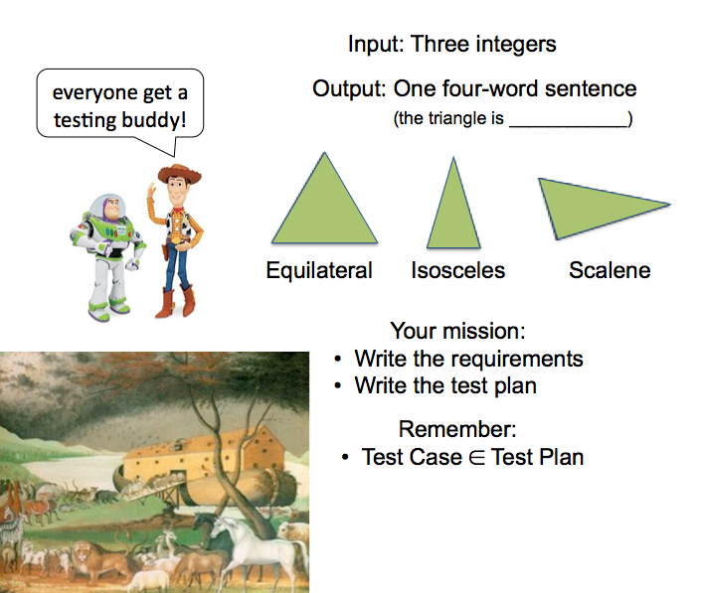
Lesson 2: The Equipoise of Testing
equipoise (noun) the balance of forces or interests

Slide 5
Lesson 3: The V-Model
REQUIREMENTS
ACCEPTANCE TESTING
ARCHITECTURAL DESIGN
SYSTEM TESTING
COMPONENT DESIGN
INTEGRATION TESTING
CODING
UNIT TESTING
DEVELOPMENT
TESTING
TESTING
From a planning perspective, the flow goes from top to bottom.
From an execution perspective, the flow goes from left to right.

Slide 6
Lesson 4ff.: Managing Functional Testing
L4 - Equivalence Partitions
L5 - Boundary Testing
L6 - Orthogonal Arrays
Practically, due to time and budget considerations, it is not possible to perform exhausting testing for each set of test data, especially when there is a large pool test cases. We need an easy way to intelligently select from the pool of test cases, such that all test scenarios are covered.
For that, we use two techniques:
Equivalence Partitioning, and Boundary Value Analysis.
Equivalence partitioning (EP) is a specification-based or black-box technique. It can be applied at any level of testing and is often a good technique to use first.
The idea behind is to divide (i.e. to partition) a set of test conditions into groups or sets that can be considered the same (i.e. the system should handle them equivalently).
In equivalence partitioning, we only test one (or very few) condition(s) from each partition, because we assume all the conditions in one partition will be handled the same way by the software.
(In other words, if one condition in a partition works, we assume all of the conditions in that partition will work. This does not mean each set of inputs from the partition would have the same output or result.)
Orthogonal arrays can further this
intelligent reduction of test cases
without compromising coverage,
by ensuring testing all pairs
(or tuples) are embedded in the
test plan’s test cases.
http://www.guru99.com/equivalence-partitioning-boundary-value-analysis.html
http://istqbexamcertification.com/what-is-equivalence-partitioning-in-software-testing/

Slide 7
Lesson 4ff.: Managing Functional Testing
A decision table is a table of all possible conditions and corresponding actions. It is used to show complicated logic without forgetting any combination of conditions. Decision tables help in testing by listing all possible input conditions
Some specification-based software testing techniques, such as decision tables and state transition testing,
are more focused on business logic
or business rules.
Decision Table Testing is a good way
to deal with a combination of inputs, which produce different results.
It helps reduce test effort in verifying each and every combinations of test data, at the same time ensuring complete coverage.
L4 - Equivalence Partitions
L5 - Boundary Testing
L6 - Orthogonal Arrays
L7 - Decision Table Testing
What are all of these
techniques designed to do?
http://www.guru99.com/software-testing-techniques-1.html
http://istqbexamcertification.com/what-is-decision-table-in-software-testing/

Slide 8
Lesson 8: Performance Testing
We discussed three...
Performance Testing
Load Testing
Stress Testing
Three ways to assess (test) system performance.
Asks the question:
“Are there any bottle-
necks? (not bugs)”
Asks the question:
“Can this program
handle the max load?”
Asks the question:
“What happens when we
exceed the max load?”
Things we check for:
Things we check for:
Things we check for:
scalability
concurrency
performance
high-load runs
  full databases
  long runs over time
  high I/O traffic
memory leaks
buffer overflows
graceful degradation
system response
security vulnerabilities
What is the biggest challenge here?

Slide 9
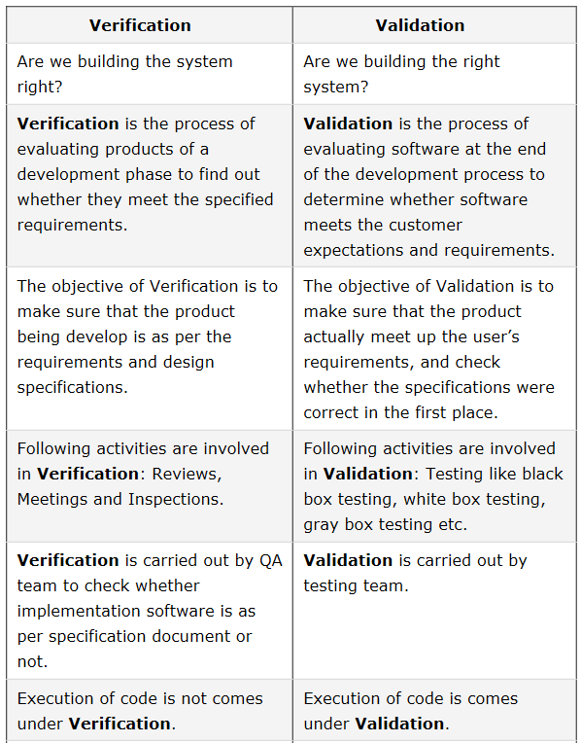
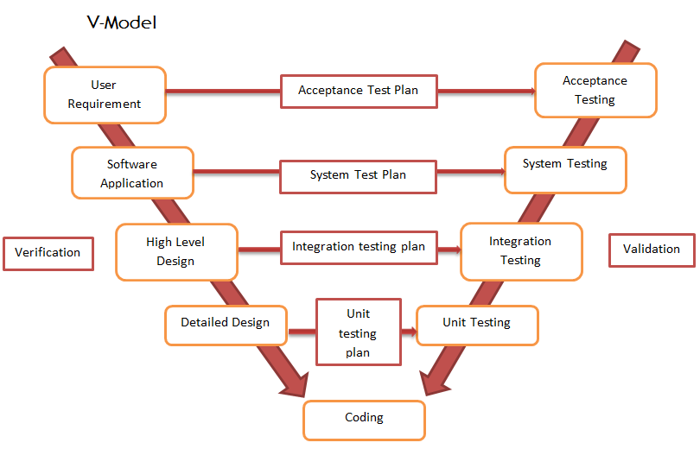



Lesson 9: V&V
Source: http://www.softwaretestingclass.com/difference-between-verification-and-validation/

Slide 10
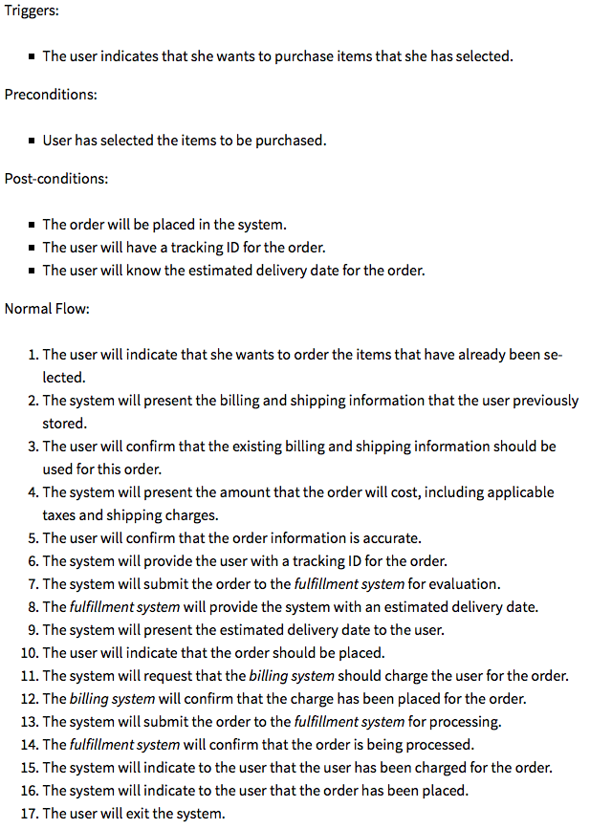
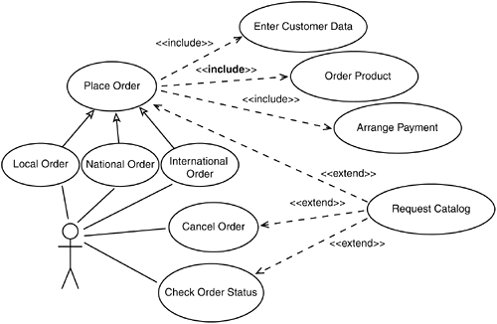
Lesson 10:
Use Case Scenarios
This is a use case scenario:
This is a use case diagram
Q: What does this have to do with testing?

Slide 11
L11: TDD
Conventional Development
Reqs
Design
Code
Test
TDD
Reqs
Design
the Test
Code
Test
A differentiating feature of test-driven development:
it makes the developer focus on the requirements
before writing the code, a subtle but important difference.
This process is not done for requirements en masse,
but for small groups of requirements at a time.
(iterative to the extreme )

Slide 12
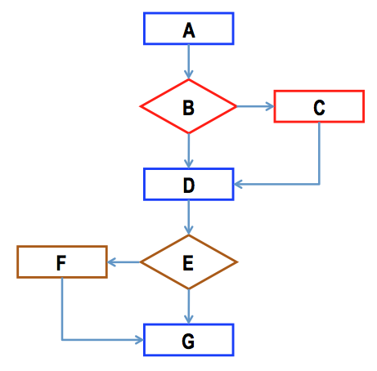
L15: White Box Testing
Describe the differences between black box and white box testing.
    What is the f-word and the s-word?
Statement vs branch vs path coverage

Slide 13
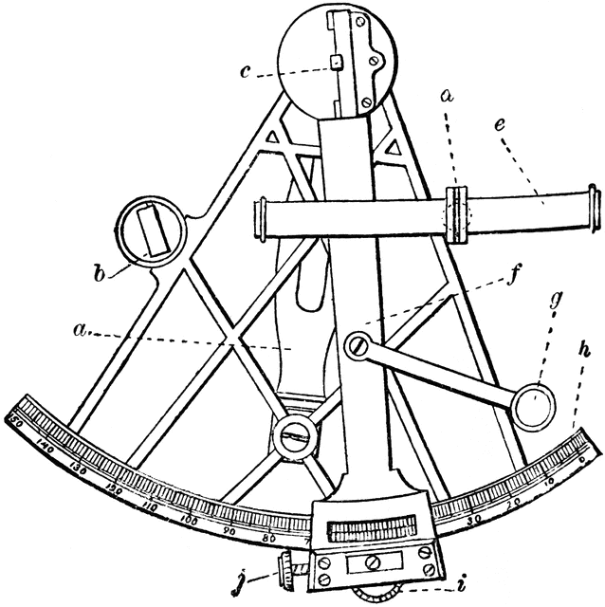
L17: Exploratory Testing
a complement to scripted testing
more purposeful than ad-hoc testing
Not aimless, but calculated, based on:
- what the tester knows about the product
- results from previous tests
- known and past problems with the system
- risk areas and magnitude of perceived risk
- recent system changes
- direct observations and gut instincts
- the nature of its users and user behavior
Ad hoc testing refers to a process of improvised, impromptu
bug searching. By definition, anyone can do ad hoc testing.
By contrast, “exploratory testing” refers to a sophisticated,
thoughtful approach to unscripted testing. (from James Bach)

Slide 14

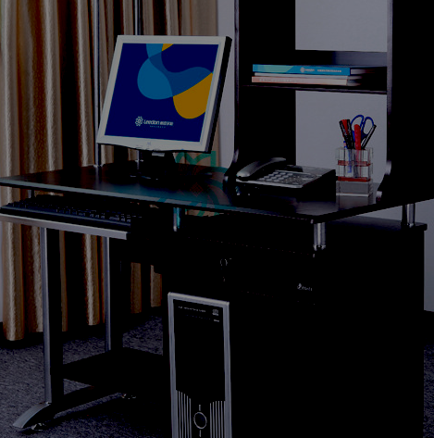
L18: Automated Testing
Manual software testing is performed by a human sitting in front of a computer.
An automated testing tool is able to playback pre-recorded and predefined actions,
compare the results to the expected behavior, and report the success or failure of
these manual tests to a test engineer.
https://support.smartbear.com/articles/testcomplete/manager-overview/

Slide 15
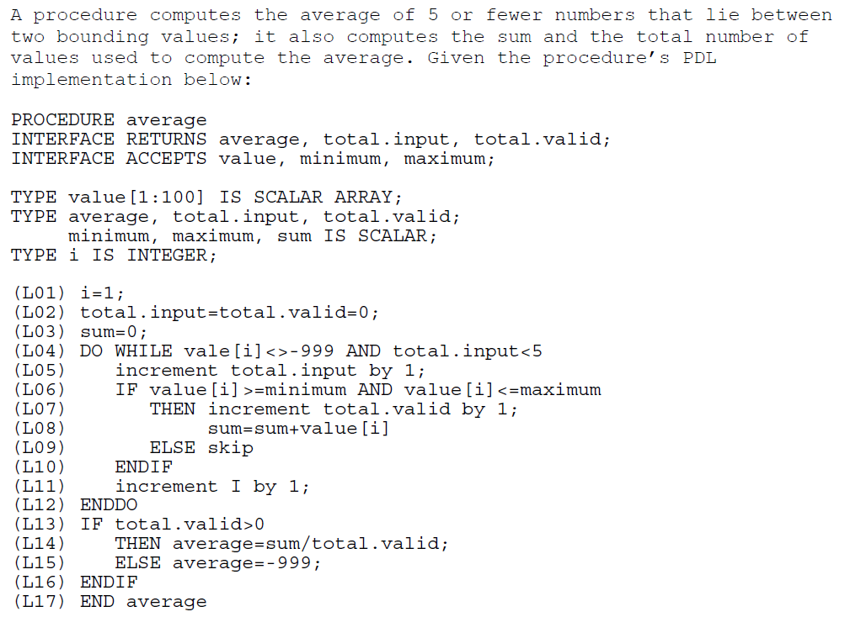
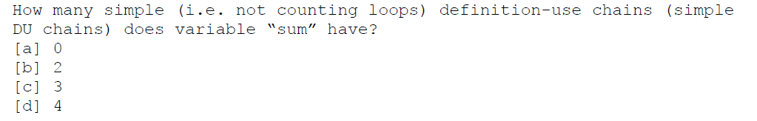
L19: Define, Use, Kill
EXAM HINT:
You won’t need to do
a problem like this one
on the exam, but you
should still be familiar
with the “gist” of it.

Slide 16
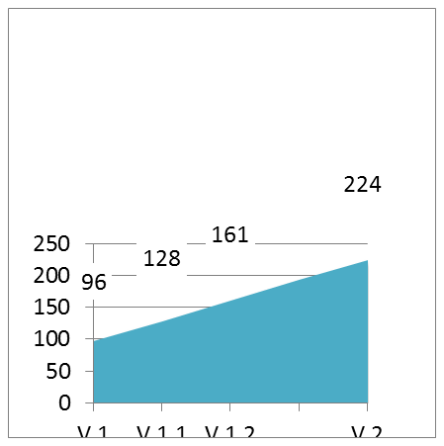
L20: Lifecycle
Testing
REQUIREMENTS
ARCHITECTURAL DESIGN
COMPONENT DESIGN
What does this show?
CODING
UNIT TESTING
Do you understand this?
INTEGRATION TESTING
REGRESSION TESTING
PROGRESSION TESTING

Slide 17

Lesson 21 & 22: Metrics
validate hunches & nullify misperceptions
lead to accurate assessments
help locate and pinpoint problems
provide historical, contextual info
B_{T}
DRE = –––––––
B_{T} + B_{U}
One product metric of
interest to the tester
Knowing what you want to accomplish
determines what you want to measure
It’s been a dry autumn...
We’ve only had .9 inches of rain in the last 8 weeks
...and we normally get 1½ - 2” during these months

Slide 18
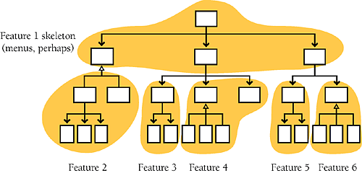
L23: Integration Testing
Integration testing is difficult,
because S/W integration is not easy
Modern example of an integration testing catastrophe?
What went wrong?
Is this a scheduling problem, or a testing problem?

Slide 19
L24: When to stop
Common Stopping Criteria:
Previously-defined coverages are met
Defect discovery rate dropped below a threshold
Projected cost of finding remaining defects exceeds cost of letting defects into production
Project team consensus
Project management decision
“...when you reasonably believe that the probability is low
that the product still has important, undiscovered problems”

Slide 20
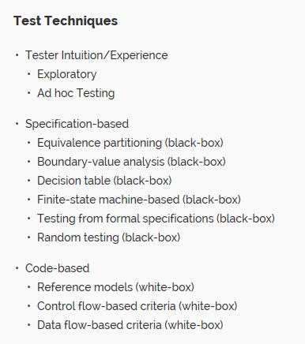
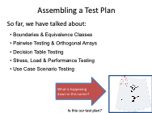
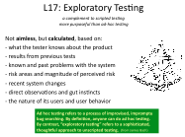
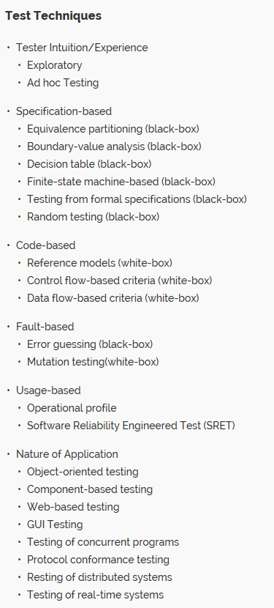
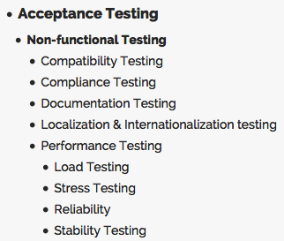
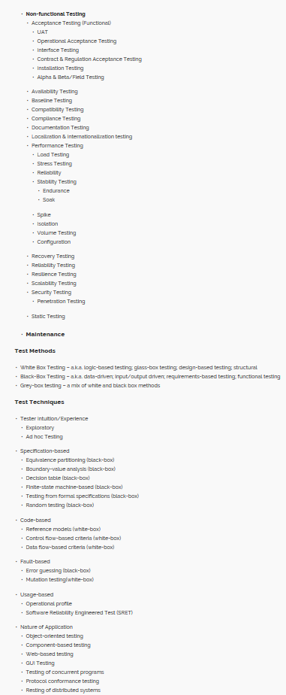
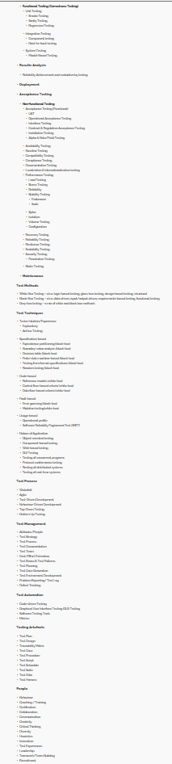
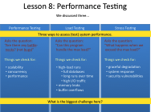
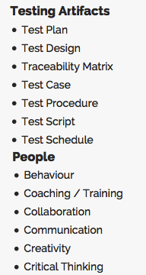
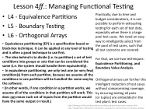
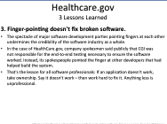
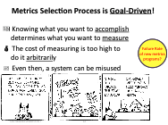
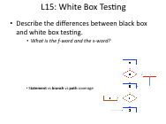
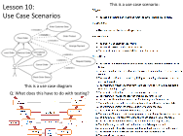
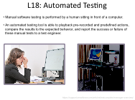
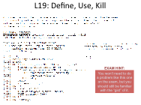
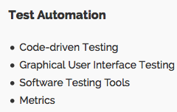
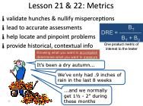
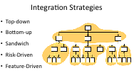
Scratching the Surface
Course Objectives
Each student should be able to:
1. Write well-organized and appropriately comprehensive
test plans using good writing techniques.
2. Effectively document test plans and results.
3. Develop software using a test-driven approach.
4. Employ effective testing strategies for different needs.
5. Write drivers, stubs, and testware as needed to
sufficiently test a program.
6. Verify a program’s correctness via a test strategy.
Why is #6
a “trick?”
http://testhuddle.com/forums/topic/taxonomy-of-software-testing-terms/

Slide 21
This is the last intentionally blank slide of the course!

